Slide 1

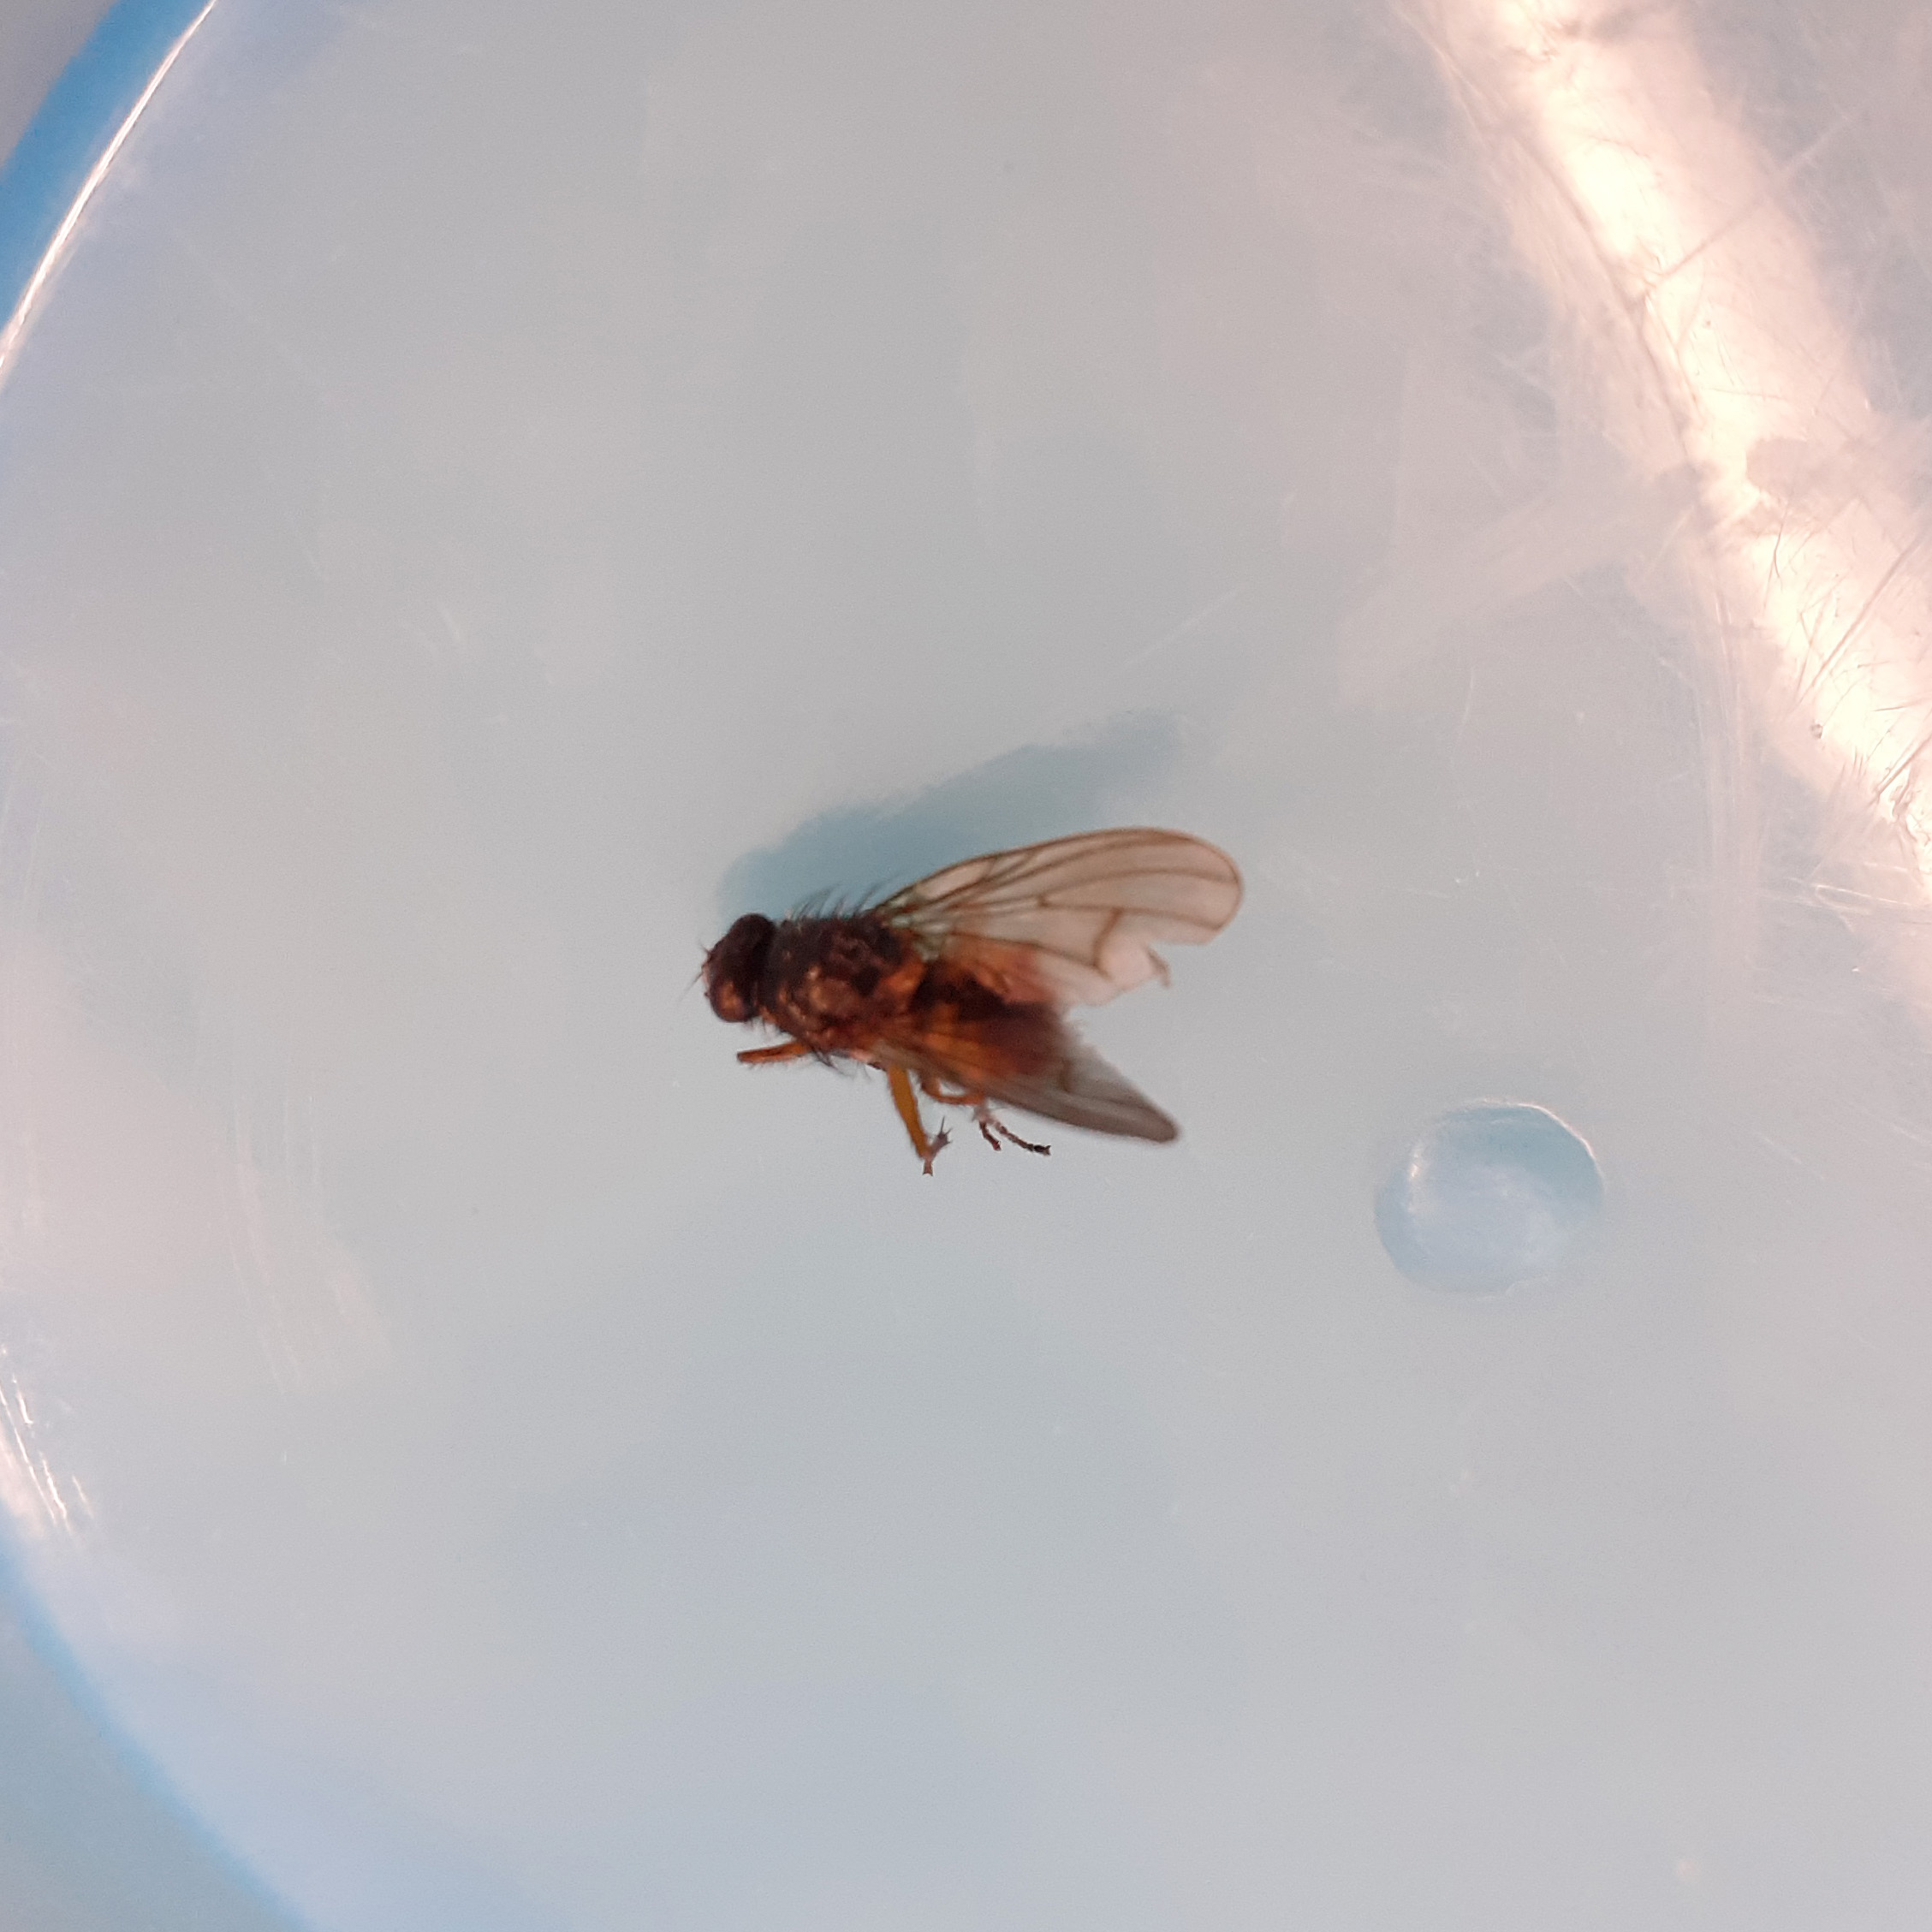
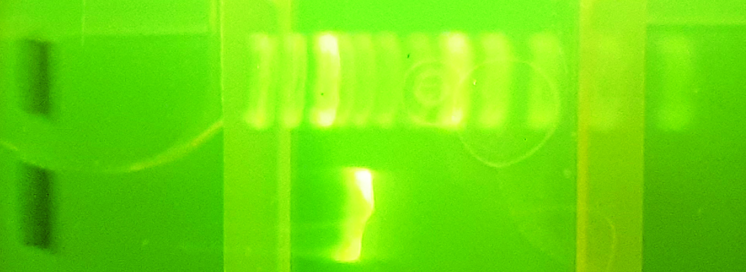
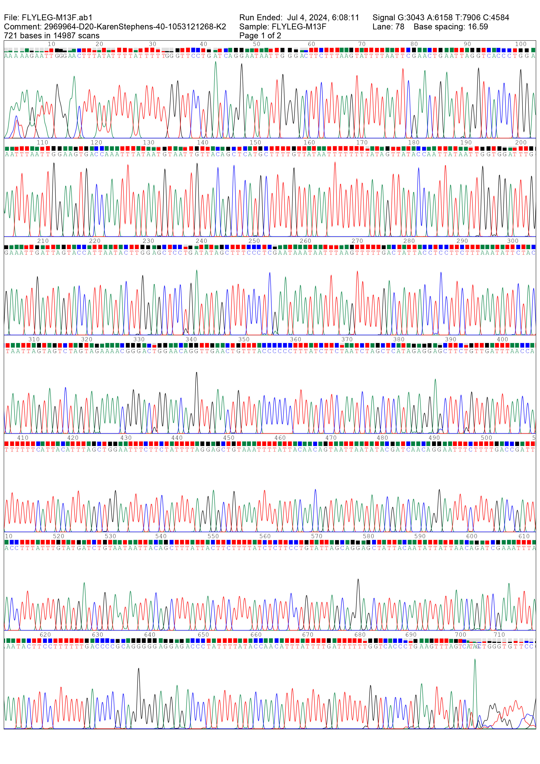
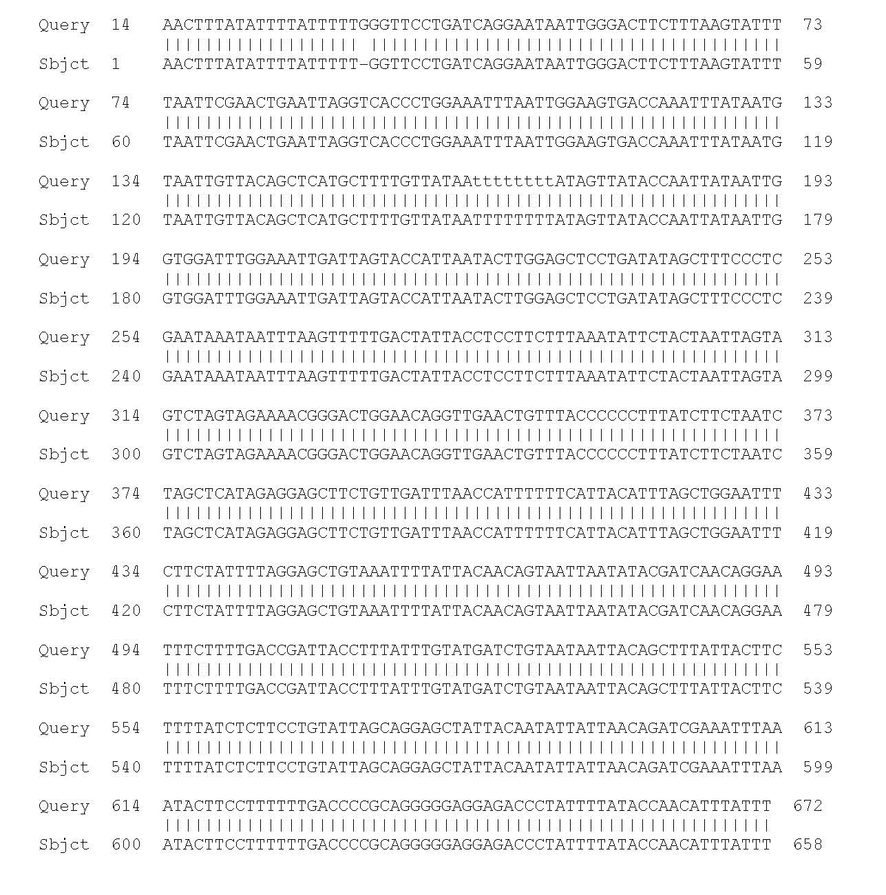
Barcoding for biodiversity:
Using DNA barcoding to identify an unknown invertebrate
By Karen Stephens
Summary
Invertebrates are the most common type of animal. This project aims to sample invertebrates from around my workplace and identify them. The invertebrates will be identified using DNA barcoding. DNA barcoding uses a DNA sequence that is constant within a species, but varies between species for identification.
Introduction
About 95% of animals are invertebrates (Eisenhauer and Hines, 2021). Invertebrates provide many ecosystem services, like pollination and organic matter recycling (Dangles and Casas, 2019), yet their roles are not well understood, invertebrate biodiversity is declining, and it is estimated that about 90% of insect species have yet to be named (Van der Sluijs, 2020). In this project we use DNA barcoding to identify invertebrates around our workplace.
This project is similar to BIOSCAN, a 5 year project looking at the genetic diversity of flying insects in the UK (Wellcome Sanger Institute, 2023). Our data will contribute to characterising invertebrate biodiversity. DNA barcode data can be used for DNA-based bioexploration and biomonitoring of insect populations over time (Chua et al., 2023).
Figure 1: My invertebrate for investigation. This 1 cm long, hairy, orange fly was found on the windowsill in Hinxton Hall at the Wellcome Genome Campus.
Method
The stages of DNA barcoding are shown. Cytochrome oxidase subunit I is used as the DNA barcode in animals (Herbert et al., 2003). DNA barcode sequence will be aligned to the NCBI database (NLM, 2021).
Collect sample
invertebrate
Extract DNA
Amplify DNA barcode by PCR
Check success
on a gel
Sequence
DNA barcode
Align DNA barcode
to database
Identify
invertebrate
Figure 2: The stages of invertebrate identification using DNA barcoding.
Results
Gel electrophoresis showed that the DNA extraction and PCR were successful in amplifying the DNA barcode from my hairy orange fly (Figure 3A). My chromatogram showed that the DNA sequence was accurate, as it had distinct and evenly-spaced peaks (Figure 3B). When aligned to the NCBI database using a BLAST, there was a match that had alignment for 100% of the sequence and an E value of 0 (very high probability of it being the same DNA sequence). This alignment was for a muscid fly, Phaonia subventa (Figure 3C).
1500 bp
1000 bp
500 bp
400 bp
300 bp
200 bp
A
100 bp
Figure 3: (A) Results from gel electrophoresis, showing a single PCR band. (B) The chromatogram shows accurate DNA sequence. (C) DNA barcode sequence alignment to a muscid fly (Phaonia subventa).
100 bp DNA ladder
PCR with Fly leg DNA
B
C
Conclusion / evaluation
Using DNA barcoding my invertebrate sample was identified as a muscid fly. Its binomial classification is Phaonia subventa. There are several very similar-looking orange flies (NatureSpot, 2024), but DNA barcoding allowed definitive identification.
During this project I got to use practical molecular biology techniques, met some very friendly people at the Wellcome Sanger Institute and learnt more about how scientific projects are run. It is fun to use proper scientific equipment and techniques to try and answer questions – I’d like to do more of this!
References
Eisenhauer, N. and Hines, J. (2021) ‘Invertebrate biodiversity and conservation’. Current Biology 31; pp R1214-R1218.
Dangles, O. and Casas, J. (2019) ‘Ecosystem services provided by insects for achieving sustainable development goals’. Ecosystems Services 35; pp109-115.
Van der Sluijs, J. P. (2020) ‘Insect decline, an emerging global environmental risk’. Current Opinion in Environmental Sustainability 46; pp 39-42.
Wellcome Sanger Institute (2023) BIOSCAN. [online] Last accessed 19th July 2024. https://www.sanger.ac.uk/collaboration/bioscan/
Chua, P. Y. S., Bourlat, S. J., Ferguson, C., Korlevic, P., Zhao, L., Ekrem, T., Meier, R. and Lawniczak, M. K. N. (2023) ‘Future of DNA-based insect monitoring.’ Trends in Genetics 39 (7); pp 531-544.
Hebert, P. D. N., Cywinska, A., Ball, S. L. and deWaard, J. R. (2003) ‘Biological identifications through DNA barcodes’. Proceedings of the Royal Society, Biological Sciences 270; pp 313–321.
National Library of Medicine (2021) NCBI Blast. [online] Last accessed 19th July 2024. https://blast.ncbi.nlm.nih.gov/Blast.cgi
NatureSpot (2024) Phaonia subventa: Species account. [online] Last accessed 19th July 2024. https://www.naturespot.org.uk/species/phaonia-subventa

Slide 2
Title of the experiment / project
By Author
Summary
What did the project set out to do? Like an overview.
Introduction
Explain the scientific terms in the project (eg. species, barcoding, phylogenetic relationship).
Should be easily readable for a non-specialist.
Figure 1: Image of something related to the project
Method
Give a step-by-step guide in bullet points / numbered points of what you will do during the project.
Results
What did we find? Describe the results obtained.
Conclusion / evaluation
Explain the results obtained - do the results fit with other work? Do they fit with expectations?
Was the project successful? What would you change another time / what did you learn?
Figure 2: Image of findings of the project.
References
Information for any sources cited in the poster.

Slide 3
Collect sample
invertebrate
Extract DNA
Amplify DNA barcode by PCR
Check success
on a gel
Sequence
DNA barcode
Align DNA barcode
to database
Identify
invertebrate
Image credits
Wellcome Connecting Science
Insect illustrations: Petra Korlević

